Slide 1
Microsoft.com/learning transition
05/21/18 - msulliv

Slide 2
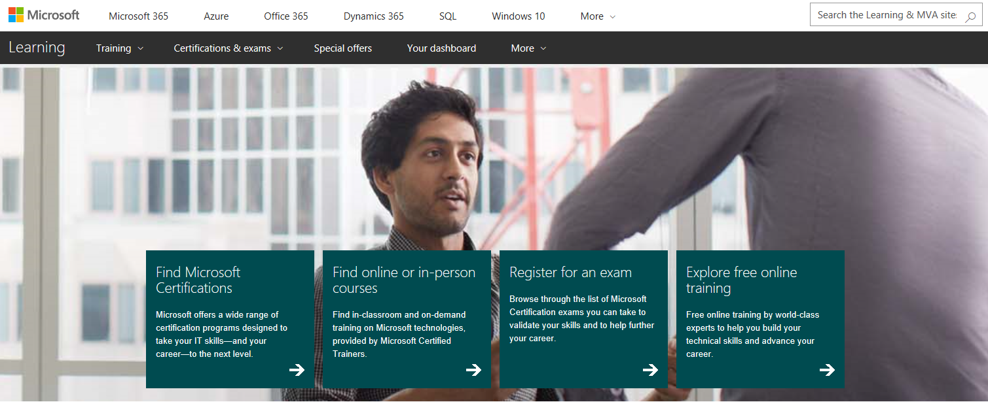


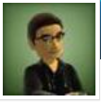



Refined /learning experience: customer emphasis
MSCOM/Learning
Learning App
All Microsoft-managed sites and services updated to share common design elements, information architecture, and terminology
Customers and partners “broad and shallow”
entry
Funnel for all external learning:
The “what” and “why”
Technical skills:
The “learn” and “do”
App App, AAD, MSA…
Labs
OpenEdx
LinkedIn Learning
Pluralsight
Success
Factors
Customers and partners “deep and targeted” entry
Triple
Crown
edX.org
Partners
Central
Exam
Books

Slide 3
MSCOM/Learning
“Broad and shallow” entry
Customers and partners wanting to discover how to learn with Microsoft.
Intent to understand
Funnel for learning
The “for who”, “why” and “what” for all Microsoft learning initiatives.
Other Microsoft-managed sites
+
Labs
LinkedIn Learning
Pluralsight
Learning App
“Deep and targeted” entry
Customers and partners who have found what they want.
Intent to learn
Triple
Crown
edX.org
Partners
Central
To sites and services that support WWL learning programs.
Tool for learning
The “learn” and “do” for all WWL learning initiatives.
All Microsoft-managed sites and services updated to share common design elements, information architecture, and terminology.
App App, AAD, MSA…

